Slide 1
Database Normalization
CH5 Week 37

Slide 2
Database Normalization
Normalization: The process of structuring data to minimize duplication and inconsistencies.
The process usually involves breaking down a single Table into two or more tables and defining relationships between those tables.
Normalization is usually done in stages, with each stage applying more rigorous rules to the types of information which can be stored in a table.

Slide 3
Normalization
Normalization: a process for analyzing the design of a relational database
  Database Design - Arrangement of attributes into entities
It permits the identification of potential problems in your database design
Concepts related to Normalization:
  KEYS and FUNCTIONAL DEPENDENCE

Slide 4
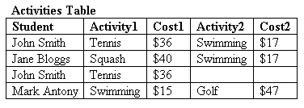
Ex: Database Normalization (1)
Sample Student Activities DB Table
Poorly Designed
  Non-unique records
    John Smith
Test the Design by developing sample reports and queries

Slide 5
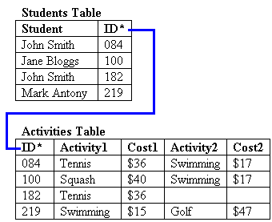
Ex: Database Normalization (2)
Created a unique “ID” for each Record in the Activities Table
Required the creation of an “ID” look-up table for reporting (Students Table)
Converted the “Flat-File into a Relational Database

Slide 6
Ex: Database Normalization (3)
Wasted Space
Redundant data entry
What about taking a 3rd Activity?
Query Difficulties - trying to find all swimmers
Data Inconsistencies - conflicting prices

Slide 7
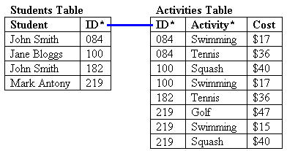
Ex: Database Normalization (4)
Students table is fine
Elimination of two columns and an Activities Table restructuring, Simplifies the Table
BUT, we still have Redundant data (activity fees) and data insertion anomalies.
Problem: If student #219
transfers we lose all references
to Golf and its price.

Slide 8
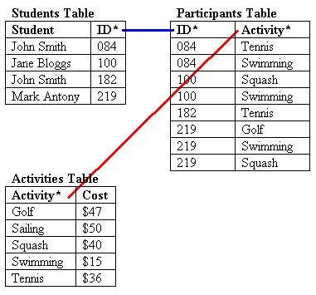
Ex: Database Normalization (5)
Modify the Design to ensure that “every non-key field is dependent on the whole key”
Creation of the Participants Table, corrects our problems and forms a union between 2 tables.
This is a Better Design!

Slide 9
Normalization
  Normalization
        We discuss four normal forms: first, second, third, and Boyce-Codd normal forms
        1NF, 2NF, 3NF, and BCNF
        Normalization is a process that “improves” a database design by generating relations that are of higher normal forms.
        The objective of normalization:
        “to create relations where every dependency is on the key, the whole key, and nothing but the key”.
91.2914

Slide 10
Normalization
There is a sequence to normal forms:
  1NF is considered the weakest,
  2NF is stronger than 1NF,
  3NF is stronger than 2NF, and
  BCNF is considered the strongest
Also,
  any relation that is in BCNF, is in 3NF;
  any relation in 3NF is in 2NF; and
  any relation in 2NF is in 1NF.
91.2914

Slide 11
Normalization
1NF
a relation in BCNF, is also in 3NF
a relation in 3NF is also in 2NF
a relation in 2NF is also in 1NF
2NF
3NF
BCNF
91.2914

Slide 12
Normalization
We consider a relation in BCNF to be fully normalized.
The benefit of higher normal forms is that update semantics for the affected data are simplified.
This means that applications required to maintain the database are simpler.
A design that has a lower normal form than another design has more redundancy. Uncontrolled redundancy can lead to data integrity problems.
First we introduce the concept of functional dependency

Slide 13
Functional Dependencies
Functional Dependencies
We say an attribute, B, has a functional dependency on another attribute, A, if for any two records, which have
the same value for A, then the values for B in these two records must be the same. We illustrate this as:
  A → B
Example: Suppose we keep track of employee email addresses, and we only track one email address for each employee. Suppose each employee is identified by their unique employee number. We say there is a functional dependency of email address on employee number:
    employee number → email address
91.2914

Slide 14
Functional Dependencies
EmpNum
EmpEmail
EmpFname
EmpLname
123
jdoe@abc.com
John
Doe
456
psmith@abc.com
Peter
Smith
555
alee1@abc.com
Alan
Lee
633
pdoe@abc.com
Peter
Doe
787
alee2@abc.com
Alan
Lee
If EmpNum is the PK then the FDs:
EmpNum → EmpEmail
EmpNum → EmpFname
EmpNum → EmpLname
must exist.

Slide 15
Functional Dependencies
EmpNum → EmpEmail
EmpNum → EmpFname
EmpNum → EmpLname
3 different ways you might see FDs depicted
EmpEmail
EmpNum
EmpFname
EmpLname
EmpNum EmpEmail EmpFname EmpLname

Slide 16
Determinant
Functional Dependency
EmpNum → EmpEmail
Attribute EmpNum is known as the determinant
  EmpNum is a determinant of EmpEmail
91.2914

Slide 17
Transitive dependency
Transitive dependency
Consider attributes A, B, and C, and where
A → B and B → C.
Functional dependencies are transitive, which means that we also have the functional dependency A → C
We say that C is transitively dependent on A through B.

Slide 18
Transitive dependency
EmpNum → DeptNum
EmpNum EmpEmail DeptNum DeptNname
DeptNum → DeptName
EmpNum EmpEmail DeptNum DeptNname
DeptName is transitively dependent on EmpNum via DeptNum
    EmpNum → DeptName
91.2914

Slide 19
Partial dependency
A partial dependency exists when an attribute B is functionally dependent on an attribute A, and A is a component of a multipart candidate key.
InvNum
LineNum
Qty
InvDate
Candidate keys: {InvNum, LineNum} InvDate is partially dependent on {InvNum, LineNum} as InvNum is a determinant of InvDate and InvNum is part of a candidate key
91.2914

Slide 20
First Normal Form
First Normal Form
We say a relation is in 1NF if all values stored in the relation are single-valued and atomic.
1NF places restrictions on the structure of relations. Values must be simple.
91.2914

Slide 21
First Normal Form
The following is not in 1NF
EmpNum
EmpPhone
EmpDegrees
123
233-9876
333
233-1231
BA, BSc, PhD
679
233-1231
BSc, MSc
EmpDegrees is a multi-valued field:
  employee 679 has two degrees: BSc and MSc
  employee 333 has three degrees: BA, BSc, PhD
91.2914

Slide 22
First Normal Form
EmpNum
EmpPhone
EmpDegrees
123
233-9876
333
233-1231
BA, BSc, PhD
679
233-1231
BSc, MSc
To obtain 1NF relations we must, without loss of information, replace the above with two relations - see next slide
91.2914

Slide 23
First Normal Form
EmployeeDegree
Employee
EmpNum
EmpDegree
EmpNum
EmpPhone
333
BA
123
233-9876
333
BSc
333
233-1231
333
PhD
679
233-1231
679
BSc
679
MSc
An outer join between Employee and EmployeeDegree will produce the information we saw before
91.2914

Slide 24
Boyce-Codd Normal Form
Boyce-Codd Normal Form
BCNF is defined very simply:
  a relation is in BCNF if it is in 1NF and if every determinant is a candidate key.
If our database will be used for OLTP (on line transaction processing), then BCNF is our target. Usually, we meet this objective. However, we might denormalize (3NF, 2NF, or 1NF) for performance reasons.
91.2914

Slide 25
Second Normal Form
Second Normal Form
A relation is in 2NF if it is in 1NF, and every non-key attribute is fully dependent on each candidate key. (That is, we don’t have any partial functional dependency.)
2NF (and 3NF) both involve the concepts of key and non-key attributes.
A key attribute is any attribute that is part of a key; any attribute that is not a key attribute, is a non-key attribute.
Relations that are not in BCNF have data redundancies
A relation in 2NF will not have any partial dependencies
91.2914

Slide 26
Second Normal Form
Consider this InvLine table (in 1NF):
InvNum
LineNum
ProdNum
Qty
InvDate
InvNum, LineNum
ProdNum, Qty
There are two candidate keys.
Qty is the only non-key attribute, and it is dependent on InvNum
InvNum
InvDate
Since there is a determinant that is not a candidate key, InvLine is not BCNF
InvLine is not 2NF since there is a partial dependency of InvDate on InvNum
InvLine is only in 1NF

Slide 27
Second Normal Form
InvLine
InvNum
LineNum
ProdNum
Qty
InvDate
The above relation has redundancies: the invoice date is repeated on each invoice line.
We can improve the database by decomposing the relation into two relations:
InvNum
LineNum
ProdNum
Qty
InvNum
InvDate
Question: What is the highest normal form for these relations? 2NF? 3NF? BCNF?
91.2914

Slide 28
Is the following relation in 2NF?
inv_no
line_no
prod_no
prod_desc
qty
91.2914

Slide 29
2NF, but not in 3NF, nor in BCNF:
EmployeeDept
ename
ssn
bdate
address
dnumber
dname
since dnumber is not a candidate key and we have:
dnumber → dname.
91.2914

Slide 30
Third Normal Form
Third Normal Form
A relation is in 3NF if the relation is in 1NF and all determinants of non-key attributes are candidate keys
That is, for any functional dependency: X → Y, where Y is a non-key attribute (or a set of non-key attributes), X is a candidate key.
This definition of 3NF differs from BCNF only in the specification of non-key attributes - 3NF is weaker than BCNF. (BCNF requires all determinants to be candidate keys.)
A relation in 3NF will not have any transitive dependencies
of non-key attribute on a candidate key through another non-key attribute.

Slide 31
Third Normal Form
Consider this Employee relation
Candidate keys are? …
EmpNum
EmpName
DeptNum
DeptName
EmpName, DeptNum, and DeptName are non-key attributes.
DeptNum determines DeptName, a non-key attribute, and DeptNum is not a candidate key.
Is the relation in 3NF? … no
Is the relation in 2NF? … yes
Is the relation in BCNF? … no
91.2914

Slide 32
Third Normal Form
EmpNum
EmpName
DeptNum
DeptName
We correct the situation by decomposing the original relation into two 3NF relations. Note the decomposition is lossless.
EmpNum
EmpName
DeptNum
DeptNum
DeptName
Verify these two relations are in 3NF.
91.2914

Slide 33
In 3NF, but not in BCNF:
Instructor teaches one course only.
student_no
course_no
instr_no
Student takes a course and has one instructor.
{student_no, course_no} → instr_no
instr_no → course_no
since we have instr_no → course-no, but instr_no is not a
Candidate key.
91.2914

Slide 34
student_no
course_no
instr_no
BCNF
student_no
instr_no
course_no
instr_no
{student_no, instr_no} → student_no
{student_no, instr_no} → instr_no
instr_no → course_no
91.2914

